Slide 1
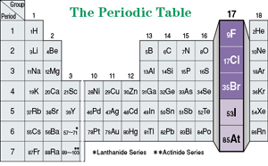
ELEMENTS OF GROUP 17

Slide 4
OCCURRENCE OF HALOGEN
All of the halogens occur in seawater as halide ions.
The concentration of the chloride ion is 0.54 M; that of the other halides is less than 10^{–4}M.
Fluoride also occurs in minerals such as CaF₂, Ca(PO₄)₃F, and Na₃AlF₆.
Chloride also occurs in the Great Salt Lake and the Dead Sea, and in extensive salt beds that contain NaCl, KCl, or MgCl₂. Part of the chlorine in your body is present as hydrochloric acid, which is a component of stomach acid.
Bromine compounds occur in the Dead Sea and
underground brines. Iodine compounds are found in small quantities in Chile saltpetre, underground brines, and sea kelp.
Iodine is essential to the function of the thyroid gland.

Slide 5
ELECTRONIC CONFIGURATION

Slide 6
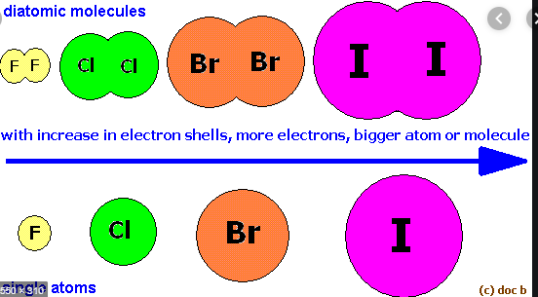
A

Slide 7
IONISATION ENTHALPY

Slide 19
MANUFACTURE OF CHLORINE

Slide 20
DEACON’S PROCESS

